Slide 1

A Major Project Review
On
DESIGN AND FABRICATION OF A LOW-COST HUMAN BODY LOWER LIMB EXOSKELETON WITH EMG
By
Under the guidance of
Dr.Pallavi Khare
M.Tech, Ph. D
Associate Professor
K AKSHITHA | (1608-20-735-012)
V SAI PRIYA | (1608-20-735-035)
N TARUN KUMAR | (1608-20-735-042)
Department of Electronics and Communication Engineering
MATRUSRI ENGINEERING COLLEGE
(An Autonomous Institution)
(Sponsored by Matrusri Education Society, Estd1980, Approved by AICTE)
(Affiliated to Osmania University, Accredited by NAAC A+ & NBA)
#16-1-486, Saidabad, Hyderabad, Telangana-500 059
www.matrusri.edu.in
2023-2024

Slide 2
CONTENTS
INTRODUCTION
LITERATURE SURVEY
PROBLEM STATEMENT
OBJECTIVE
PROPOSED BLOCK DIAGRAM
COMPONENTS
FLOWCHART
RESULT
TIMELINE
CONCLUSION
REFERENCES

Slide 3
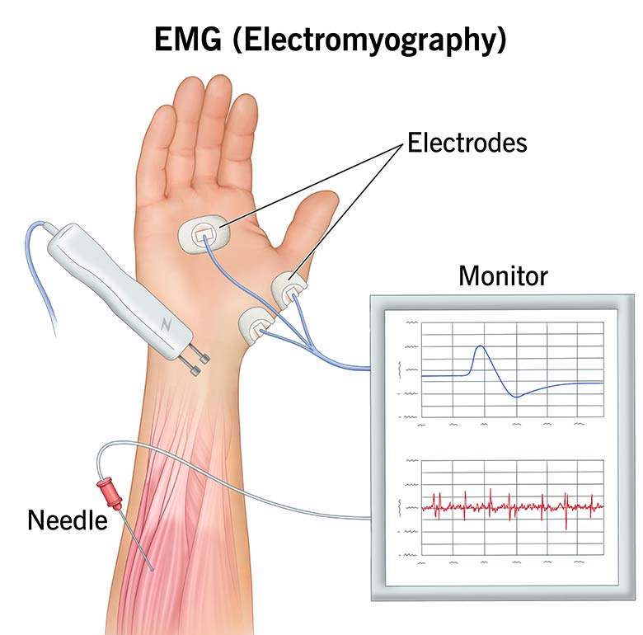
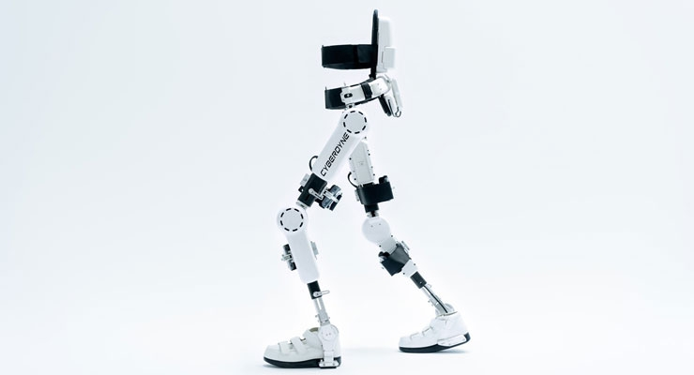
INTRODUCTION
An exoskeleton is a wearable robotic device designed to enhance human physical capabilities by providing external support and augmenting strength and endurance.
Electromyography (EMG) sensors are devices that detect muscles movement and convert into electrical impulses.

Slide 4
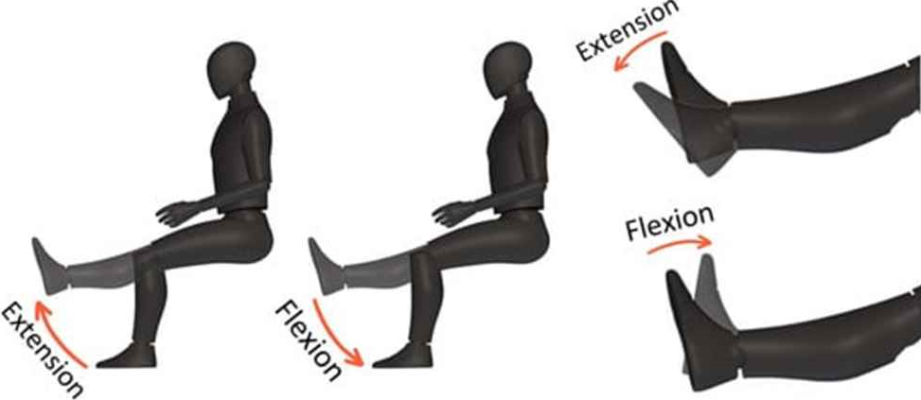
LITERATURE SURVEY
S.NO | TITLE | AUTHOR | TECHNIQUE | YEAR
1. | Design of a Lower Limb Exoskeleton: Robust Control, Simulation and Experimental Results | E. Anyuli Alvarez Salcido, Daniel Centeno-Barreda et al. | A Robust control algorithm for a knee and ankle joint exoskeleton, designed for ACL(anterior cruciate ligament) injuries. | 2023

Slide 5
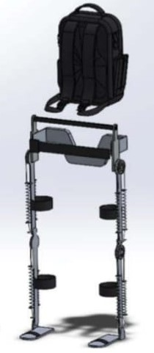
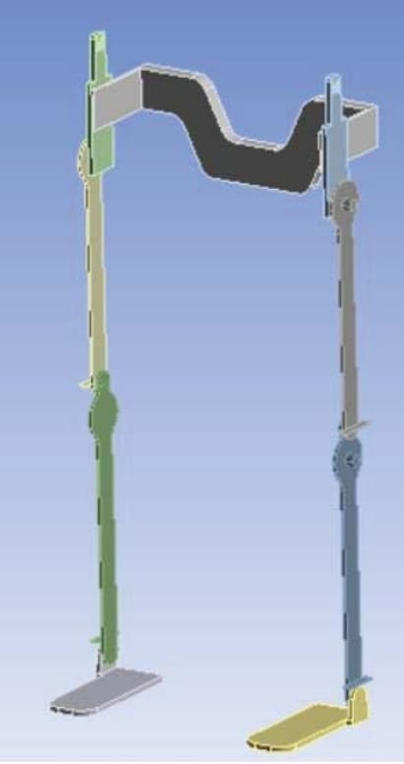
S.NO | TITLE | AUTHOR | TECHNIQUE | YEAR
2. | Design and Simulation of Low-Cost Lower Limb Exoskeleton for Rehabilitation Exercise | Nilam Abdullah,S. Ramesh et al. | Developed a low-cost 20 kg lower limb exoskeleton with 3D modelling, static simulations, ANSYS and Finite Element analysis assistance for paraplegic patients. | 2023

Slide 6
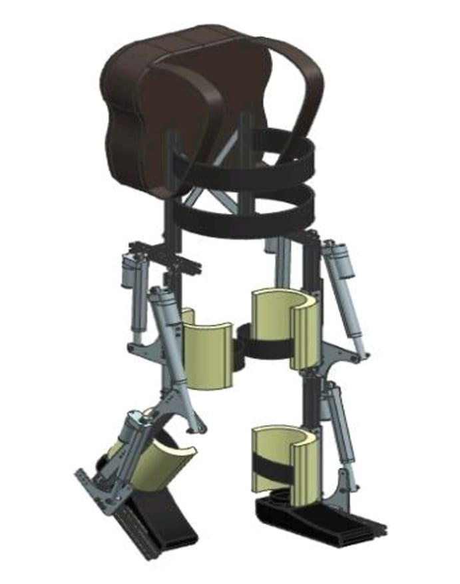
S.NO | TITLE | AUTHOR | TECHNIQUE | YEAR
3. | Design of a Low-Cost Lower Limb Rehabilitation Exoskeleton System | Ullas U and Rajendrakumar P K | Developed a low-cost lower limb exoskeleton system using electric linear actuators, designed for various physical attributes. | 2022

Slide 7
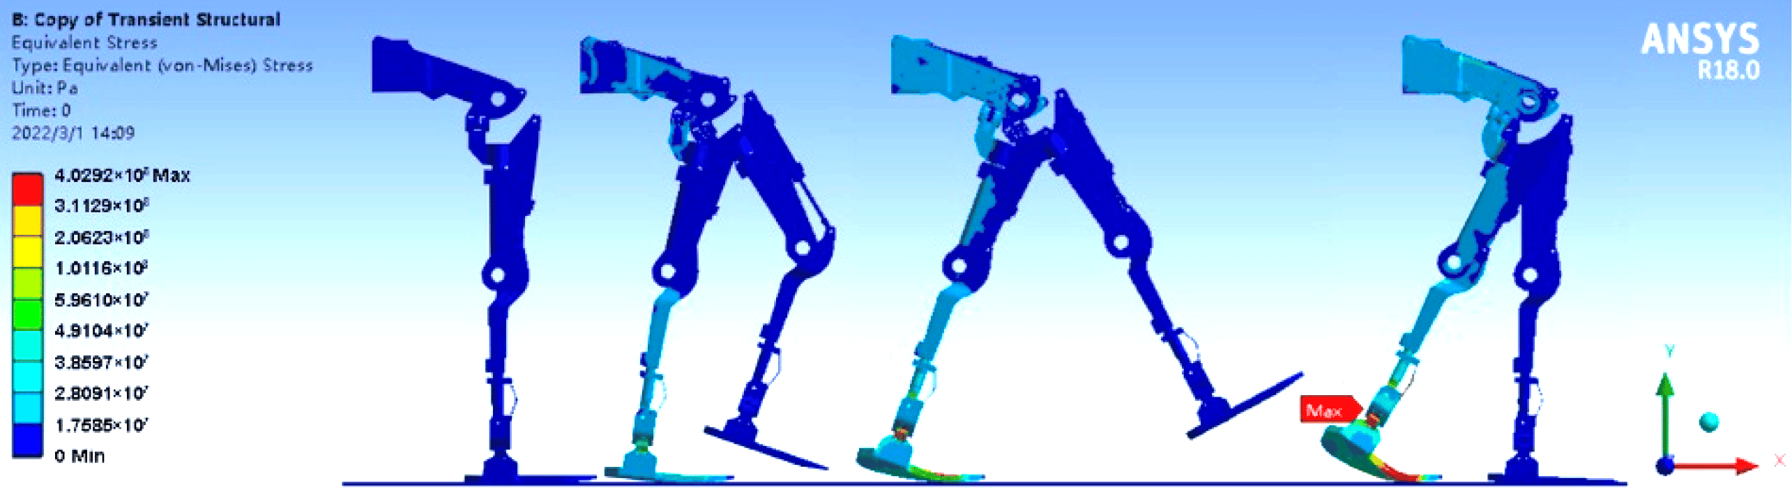
S.NO | TITLE | AUTHOR | TECHNIQUE | YEAR
4. | Design and Analysis of Lower Body Exoskeleton | Manoj M. Jadhav, Komal C. Kale et al. | Developed a lower-body exoskeleton for industrial walking, carrying heavy loads using ANSYS, and stresses for an 80kg human. | 2021

Slide 8
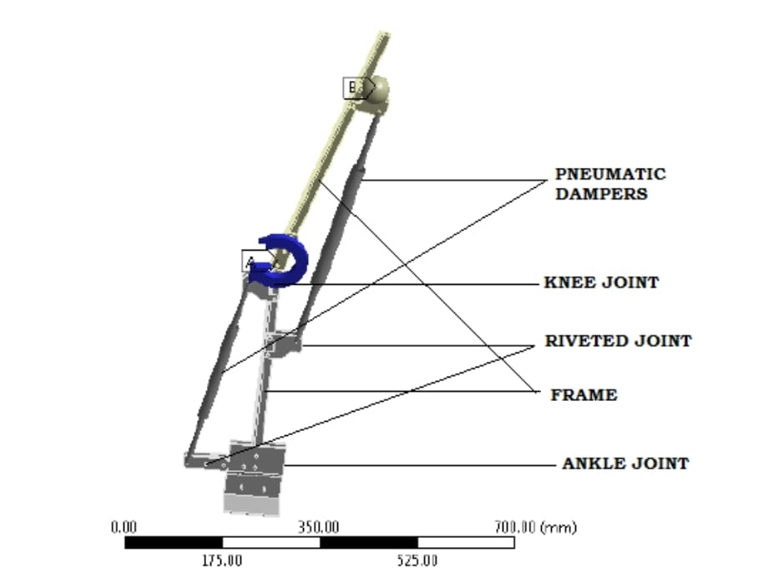
S.NO | TITLE | AUTHOR | TECHNIQUE | YEAR
5. | Design and Fabrication of Lower Limb Exoskeleton | Rakesh. C, Harish Kumar Yadav et al. | Developed a portable, energy-neutral exoskeleton for knee-joint assistance during walking, with pneumatic dampers to mimic natural joint moments and recycle energy. | 2020

Slide 9

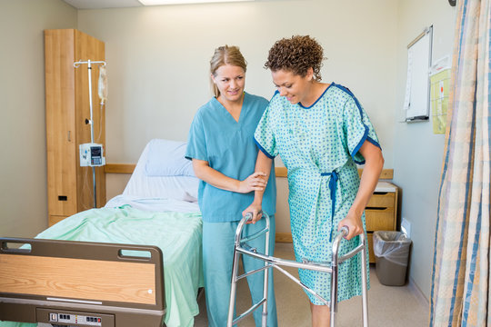
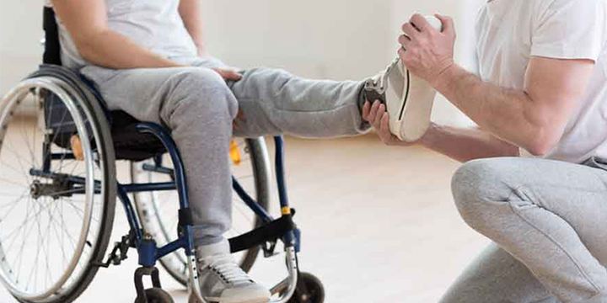
PROBLEM STATEMENT
In the current scenario, the conventional leg arrangements for semi-paralysis patients or people with weak lower limbs don’t provide the desired functionality as they have low adaptability, low motion amplification and high rigidity which has low efficiency with a high cost.

Slide 10
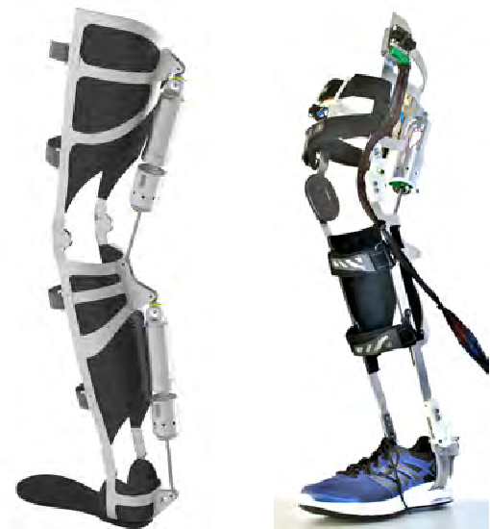
OBJECTIVE
To create a cost-effective lower limb exoskeleton with Electromyography(EMG) Technology to address mobility challenges in individuals with weakened muscles due to accidents.

Slide 11
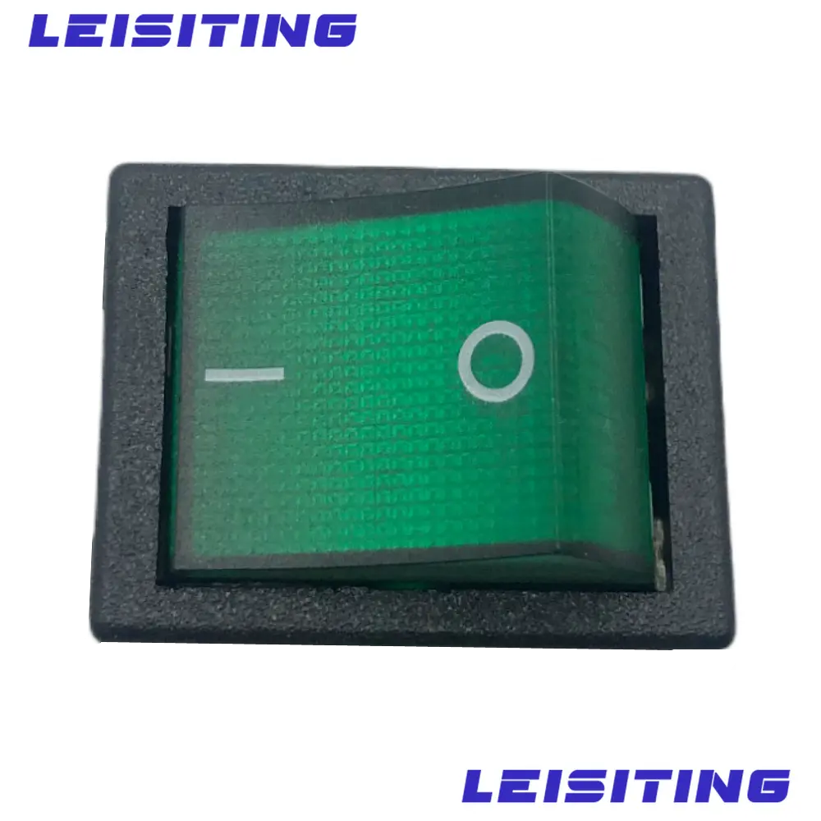
BLOCK DIAGRAM
Battery 9V
USB Port
SMPS
YY-D-50-5
Knee
Joint
Electrode
EMG Sensor
Servo Motor
MG 995
Ankle
Joint
Arduino
NANO
(ATmega328P)
Exoskeleton
SMPS – Switched Mode Power Supply
EMG - Electromyography Sensor

Slide 12
COMPONENTS
BATTERY
EMG SENSOR
ARDUINO NANO
SMPS
MG995 SERVO MOTOR
ALUMINIUM FRAME
VELCRO BAND
SWITCH

Slide 13
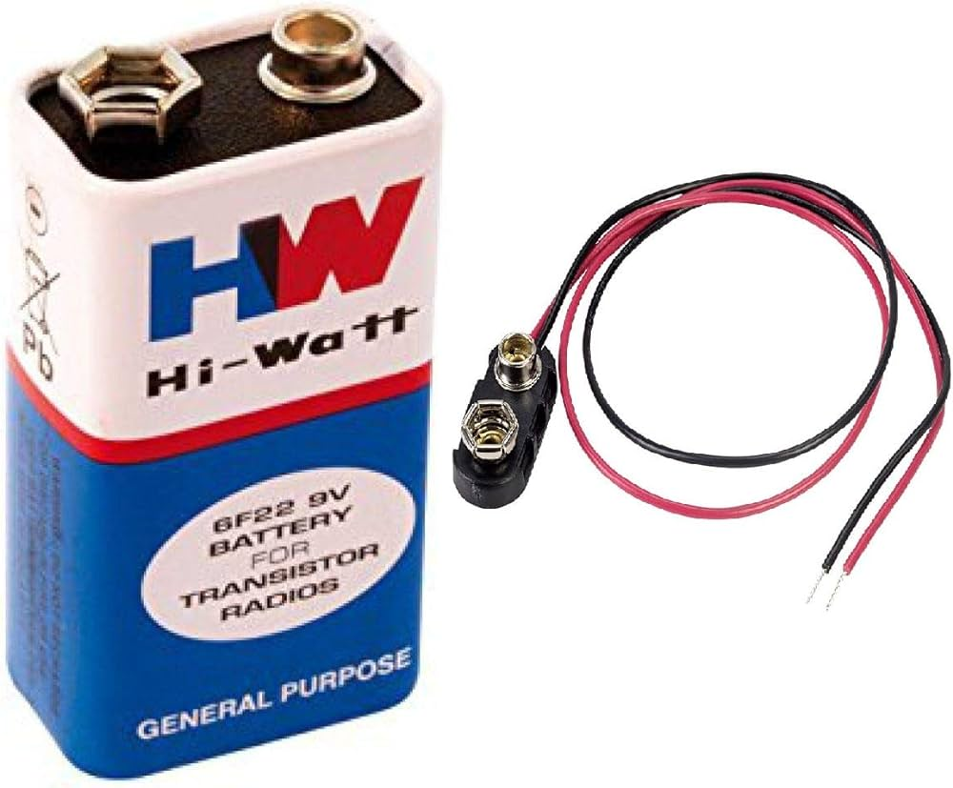
BATTERY
Voltage : 9V
Capacity : 400mAh to 600mAh
Chemistry : Zinc Carbon
Dimensions : 48.5mm x 26.5mm x 17.5mm.

Slide 14
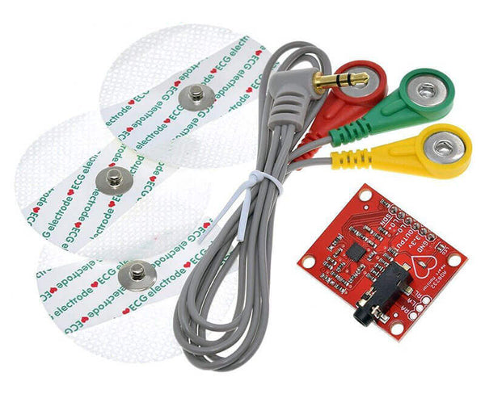
EMG SENSOR
An EMG sensor V3.0 detects and measures the electrical signals generated by muscle contractions, enabling monitoring of muscle activity and movement patterns for applications in medical diagnostics, rehabilitation, and human-computer interaction.
Electrode pad diameter: 52 mm
Cable length: 2.5 meters
Weight: 30 g
Power supply: Normally ±9V dual power supply
Dimension of module: 33.5 x 26 x 12 mm
Operating voltage: 5V

Slide 15
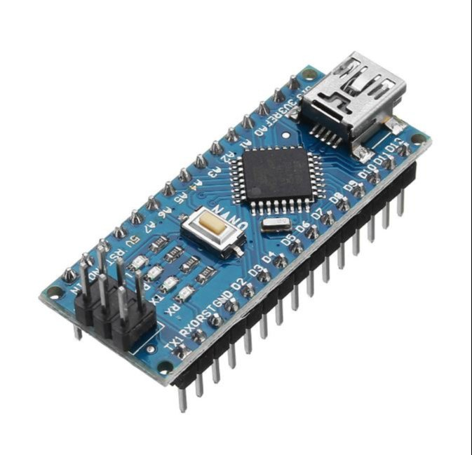
ARDUINO NANO
The Arduino Nano is a small, complete, and breadboard-friendly board based on the ATmega328P microcontroller. It's similar to the Arduino Uno but with a smaller form factor, making it ideal for compact projectsMicrocontroller: ATmega328P
Microcontroller: ATmega328P
Operating Voltage: 5V
Input Voltage (recommended): 7-12V
Input Voltage (limit): 6-20V
Digital I/O Pins: 14 (of which 6 provide PWM output)
Analog Input Pins: 8
DC Current per I/O Pin: 40 mA
Flash Memory: 32 KB (ATmega328P) of which 2 KB used by bootloader
SRAM: 2 KB (ATmega328P)
EEPROM: 1 KB (ATmega328P)
Clock Speed: 16 MHz
Dimensions: 18 x 45 mm

Slide 16
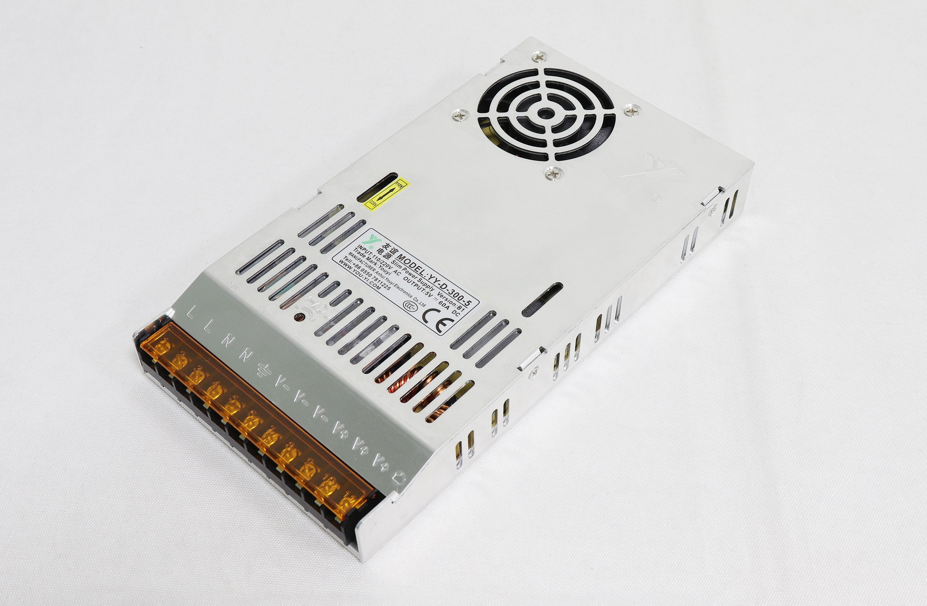
SMPS
A switching mode power supply (SMPS) is a module that converts AC voltage to DC voltage and is used to control the mechanical torque of a servo Motor.
Model: YY-D-50-5
Input Voltage: 85-264 VAC
Output Voltage: 5VDC
Efficiency: 89%
Output Current : 10 Amps

Slide 17
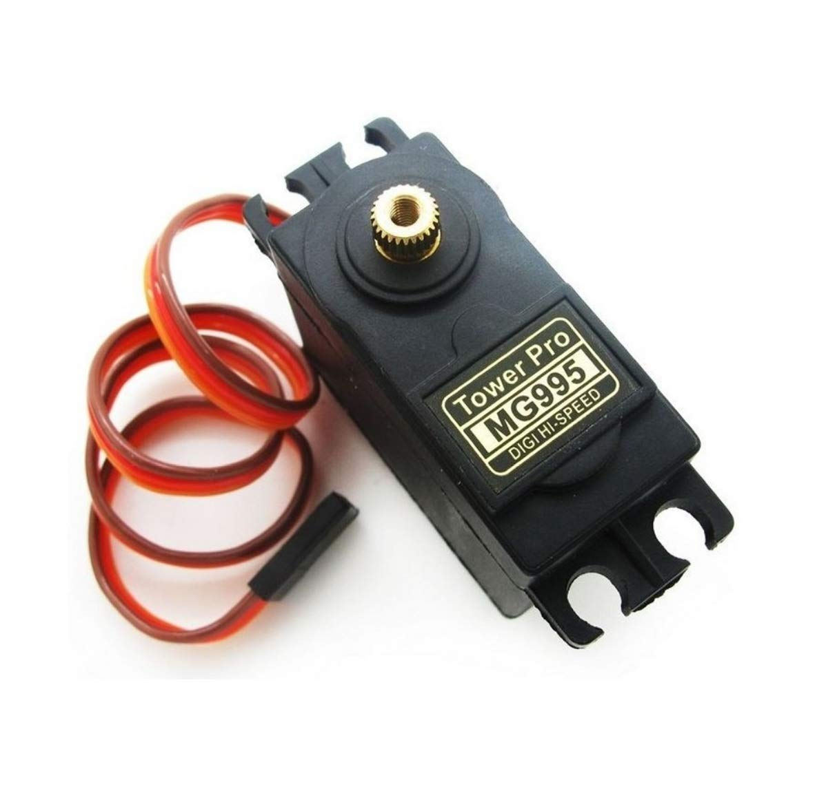
SERVO MOTOR
The MG995 is a popular standard-sized servo motor commonly used in hobbyist projects and robotics. It features a torque output suitable for various applications, precise control over angular position, and compatibility with most microcontrollers, making it a versatile choice for motion control systems.
Voltage : 4.8V – 6.6V
RPM : 0.2s/60 degrees (4.8v),0.16s/60 degrees(6v)
Torque : 10kg/cm
Angle:180 degrees
Dimensions : 40mm x 20mm x 43mm
Weight : 55g

Slide 18
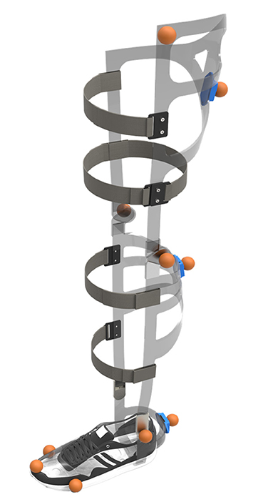
ALUMINIUM FRAME
An aluminum frame for an exoskeleton is a lightweight and durable structure designed to support and distribute loads in an exoskeletal system, providing strength and stability for enhanced mobility and functionality.
Material: Aluminum alloy (e.g., 6061 or 7075) known for its lightweight yet sturdy properties.
Dimensions: Length, width, and height tailored to fit the wearer comfortably while providing structural integrity and support.
Thickness: Typically ranges from 1.5mm to 3mm, balancing strength and weight considerations.
Weight: Kept as low as possible to minimize user fatigue while providing sufficient strength and durability.

Slide 19
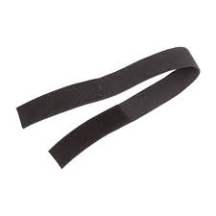
VELCRO BAND
A Velcro band is a fastening system comprising two strips of fabric, one with tiny hooks and the other with loops, allowing for quick and adjustable closure in various applications such as securing clothing, accessories, or organizing cables and equipment.
Material : Nylon fabric
Size : 10mm-50mm width , 2mm-5mm Thickness
Closure mechanism : Velcro hook , loop fasteners

Slide 20
SWITCH
The Double Pole Canal R Series Rocker Switch, identified by its green color, is a robust electrical switch capable of handling up to 20A of current.

Slide 21
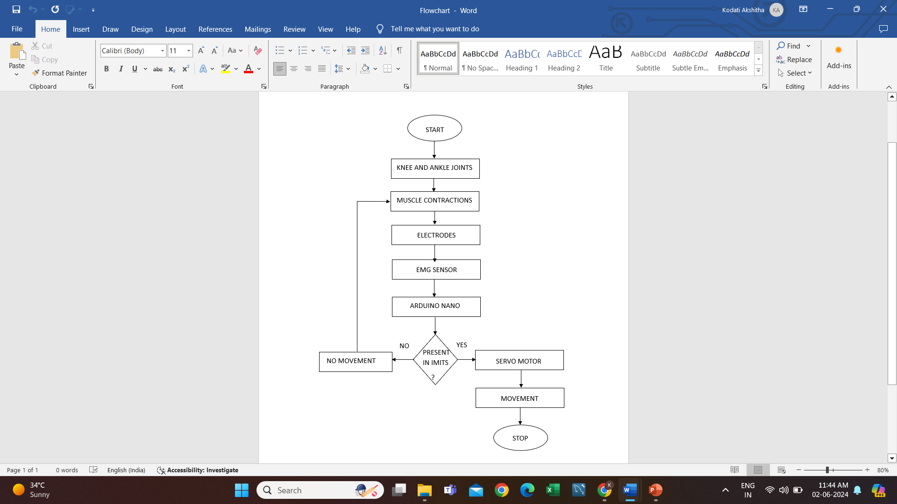
FLOWCHART

Slide 22
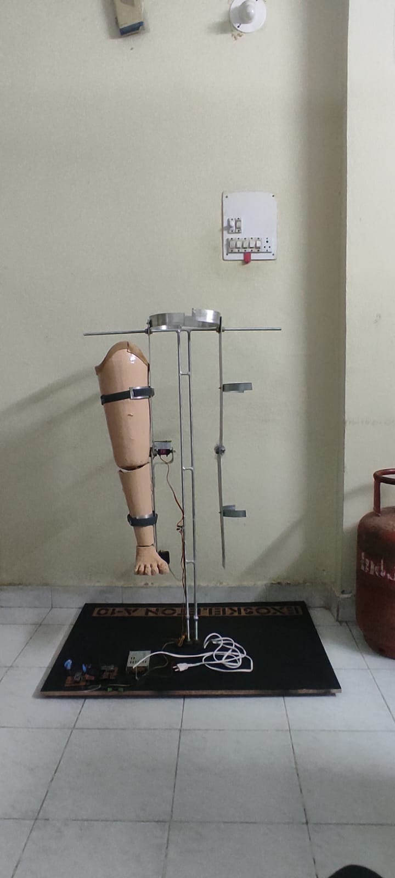
RESULT
FINAL EXOSKELETON

Slide 23
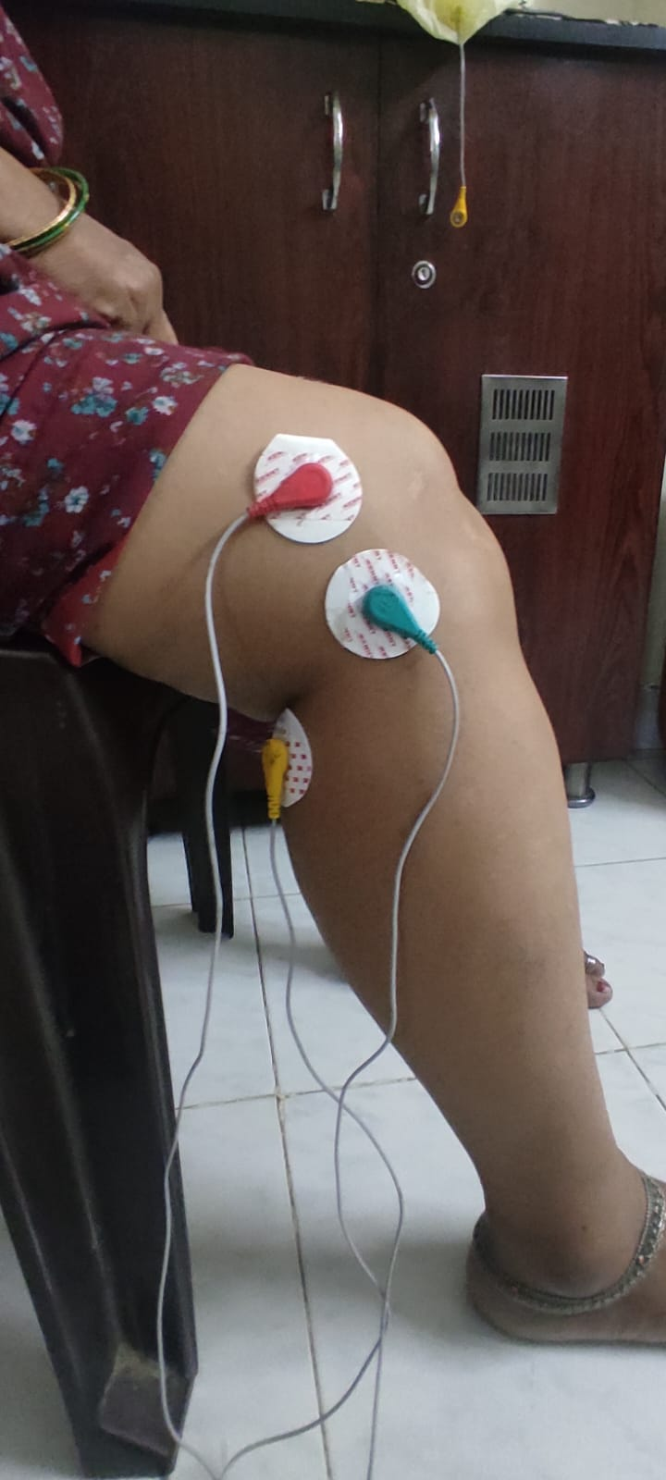
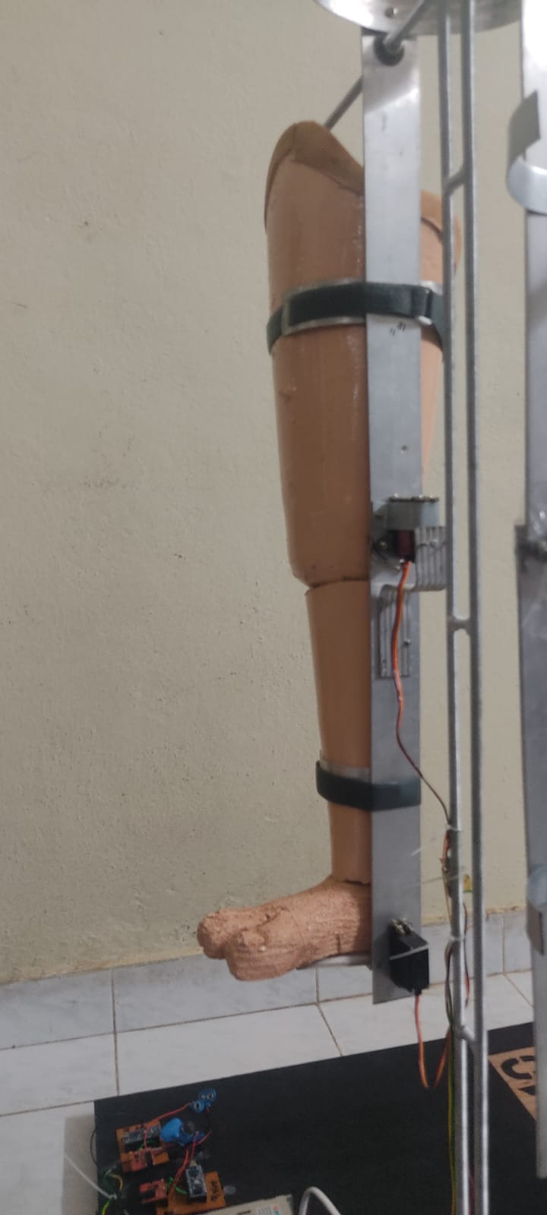
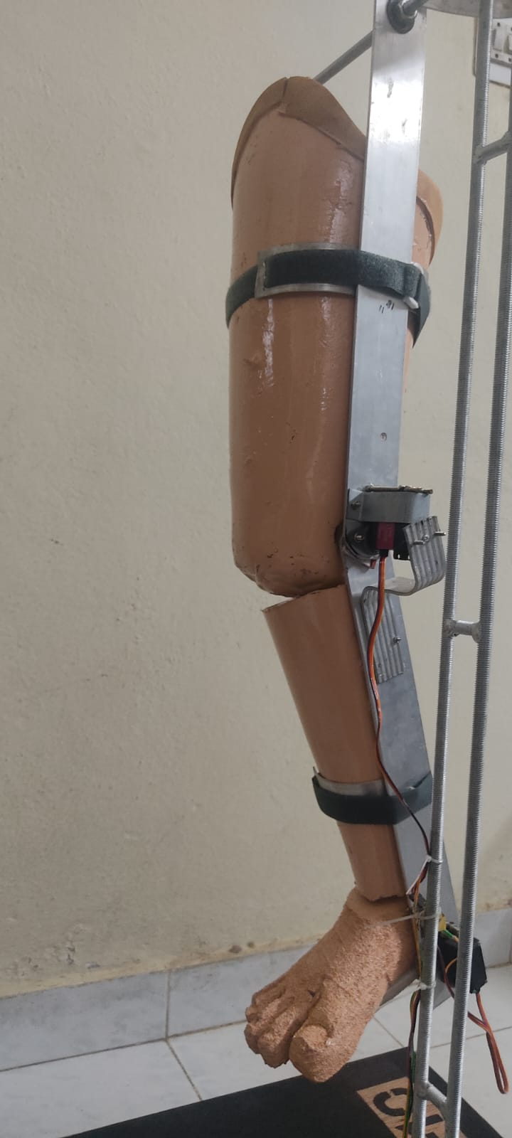
EMG on Knee joint
Normal Position of Knee
Knee Position Changed by 55 degrees

Slide 24
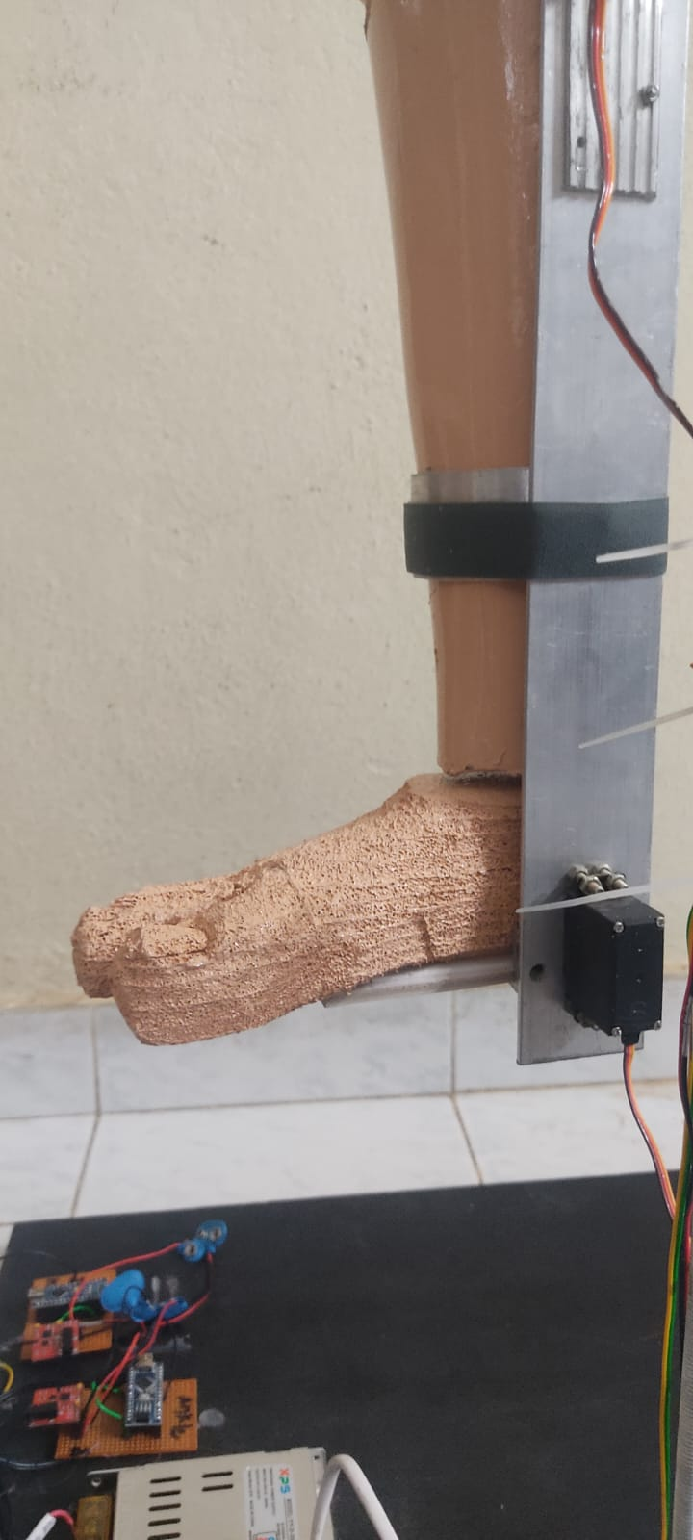
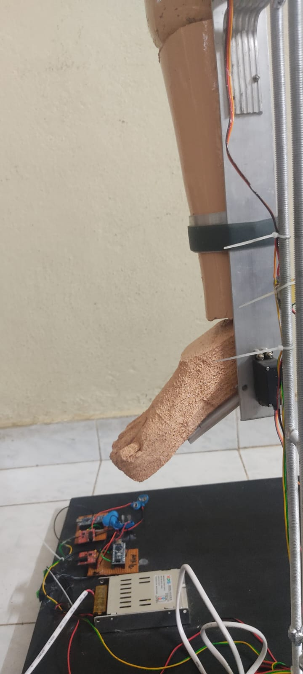
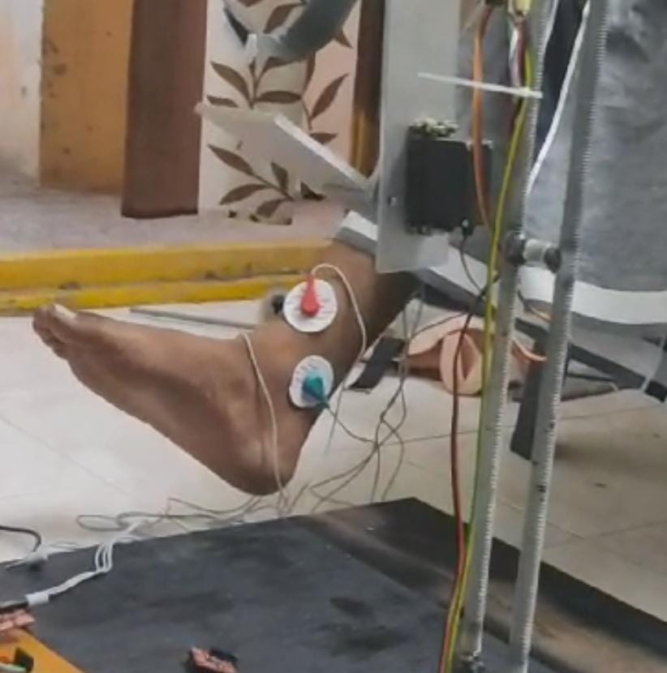
EMG on Ankle joint
Normal Position of Ankle
Ankle Position Changed by 65 degrees

Slide 25
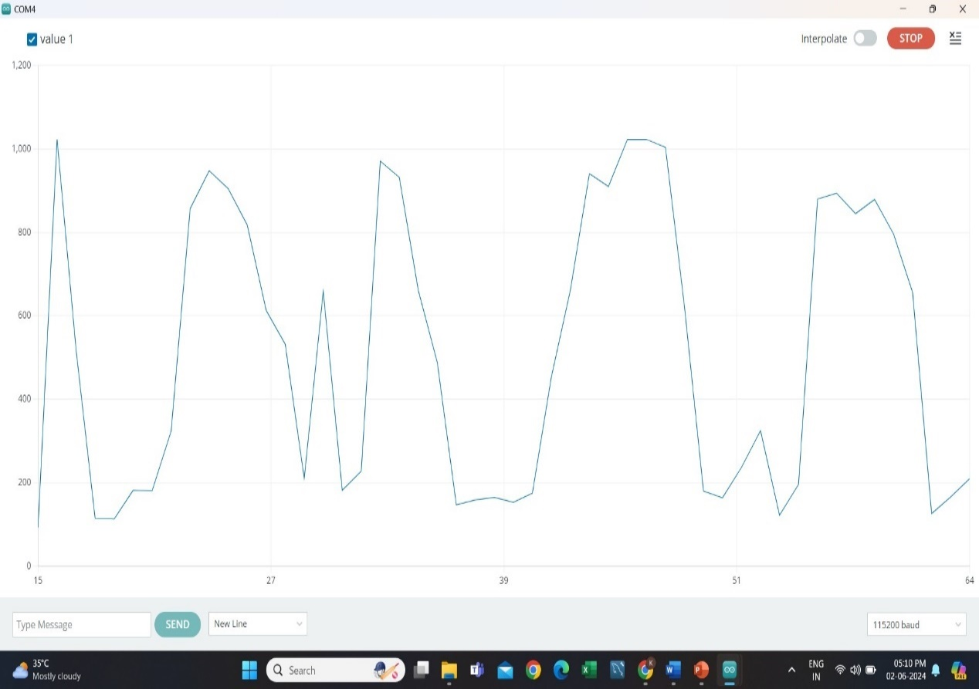
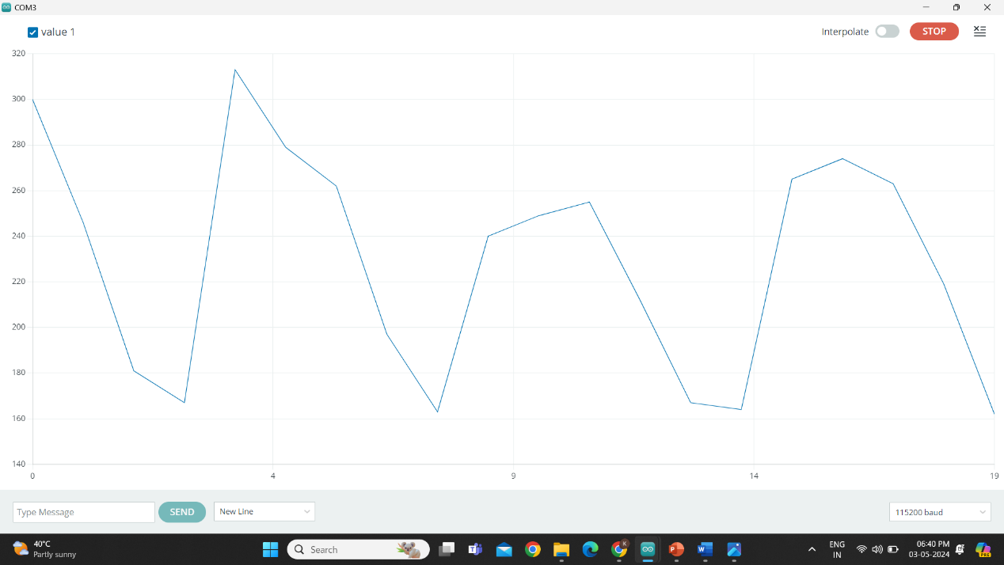
Arduino Serial Plotter for Knee
Arduino Serial Plotter for Ankle

Slide 26
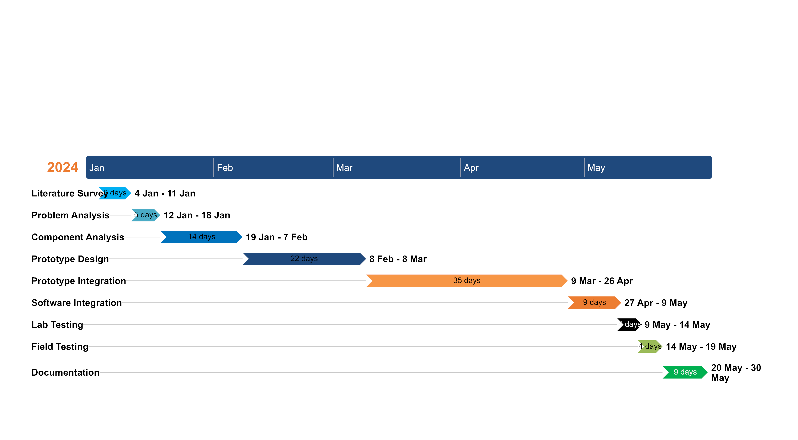
TIMELINE

Slide 27
CONCLUSION
In conclusion, the development of an inexpensive EMG-based lower limb exoskeleton marks significant progress in assistive technology for rehabilitation. This system uses electromyography sensors and servo motors to control joint angles, promoting natural walking during rehabilitation and increasing accessibility for those with limited mobility. Future advancements include adding a second leg for bilateral assistance and using Brain-Computer Interface (BCI) technology with ECG for improved control and coordination.

Slide 28
REFERENCES
[1]. Design of a Lower Limb Exoskeleton: Robust Control, Simulation and Experimental Results by Salcido, E.A.A.; Centeno-Barreda, D.; Rosales, Y.; Lopéz-Gutiérrez, R.; Salazar, S.; Lozano, R. Design of a Lower Limb Exoskeleton: Robust Control, Simulation and Experimental Results. Algorithms 2023, 16, 449. https:// doi.org/10.3390/a16090449
[2]. Design and Simulation of Low-Cost Lower Limb Exoskeleton for Rehabilitation Exercise by Nilam Abdullah,S. Ramesh. AIP Conference Proceedings 2643, 050005 (2023).
[3]. Design of a Low-Cost Lower Limb Rehabilitation Exoskeleton System. : Ullas U and P K Rajendrakumar 2021 IOP Conf. Ser.: Mater. Sci. Eng. 1132 012008.
[4]. Design and Analysis of Lower Body Exoskeleton. © 2021 IJCRT | Volume 9, Issue 7 July 2021 | ISSN: 2320-2882
[5]. Design and Fabrication of Lower Limb Exoskeleton. Rakesh.C1 , S.M.Danish2 , Shivam2 , Harish Kumar Yadav2 , Atinder Pal Singh2 Assistant Professor, Department of Mechanical Engineering.

Slide 29
[6]. Improvement of energy consumption for a lower limb exoskeleton through verticalization time optimization Sergey Jatsun, Sergei Savin, Andrey Yatsun , Department of Mechanics, Mechatronics and Robotics, Southwest State University, Kursk, Russia
[7]. Lower limb rehabilitation exoskeleton robot: A review Jinman Zhou1 , Shuo Yang1,2 and Qiang Xue1,2. Advances in Mechanical Engineering 2021, Vol. 13(4) 1–17 The Author(s) 2021 DOI: 10.1177/16878140211011862
[8]. Design and Manufacturing of A Lower Limb Exoskeleton Praseeda Prabhu Department of Mechanical Engineering Mumbai, India. International Journal of Engineering Research & Technology (IJERT) ISSN: 2278-0181 Published by, www.ijert.org NTASU - 2020 Conference Proceedings
[9]. Design and Experimental Evaluation of a Lower-Limb Exoskeleton for Assisting Workers With Motorized Tuning of Squat Heights Yao Tu , Aibin Zhu , Member, IEEE, Jiyuan Song, Xiaodong Zhang, Member, IEEE, and Guangzhong Cao , Senior Member, IEEE.
[10]. Review of hybrid exoskeletons to restore gait following spinal cord injury Antonio J. del-Ama, Eng MSc;1–2* Aikaterini D. Koutsou, Eng MSc;2 Juan C.

Slide 30
THANK YOU

